Slide 1
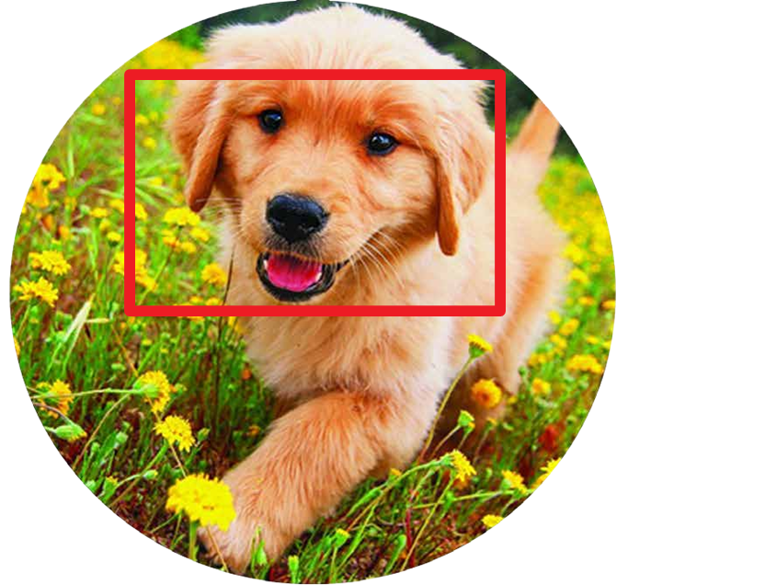
Object Localization
What object is there in the picture ...and where is it?
(Single Object)

Slide 2
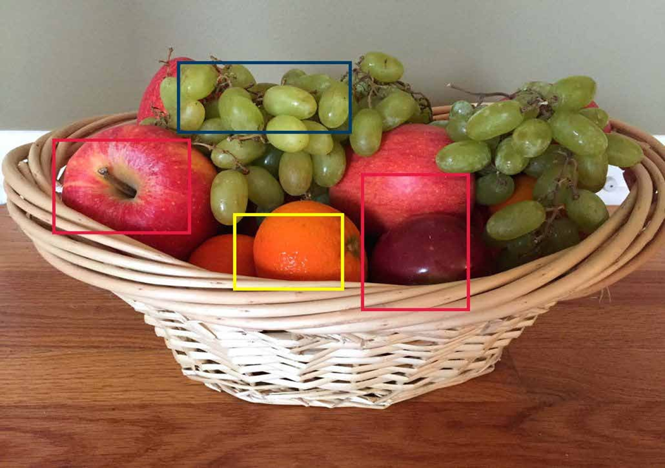
Object Detection
What object is there in the picture ...and where is it?
(Multiple objects)

Slide 3
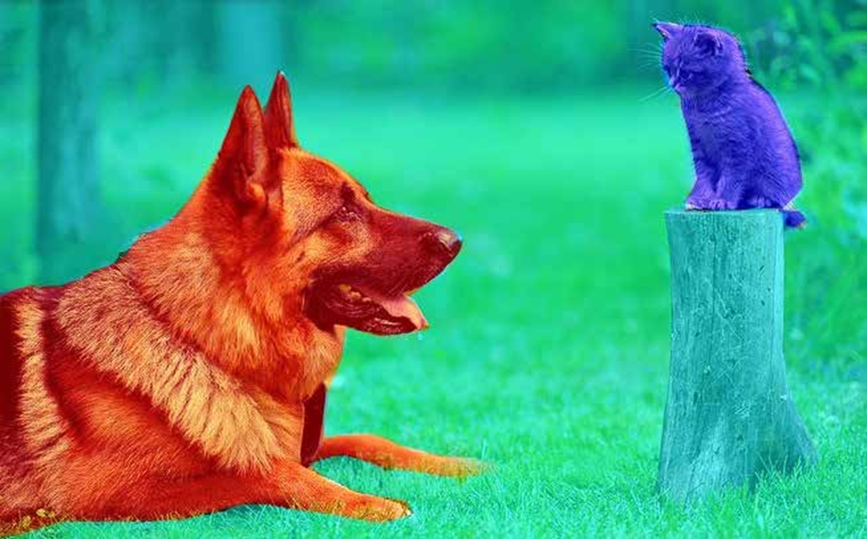
Background
Cat
Dog
Semantic Segmentation
Understanding the picture at pixel level

Slide 4

Instance Segmentation
Understanding each instance at pixel level

Slide 5
Object Localization
Working with single object picture

Slide 6
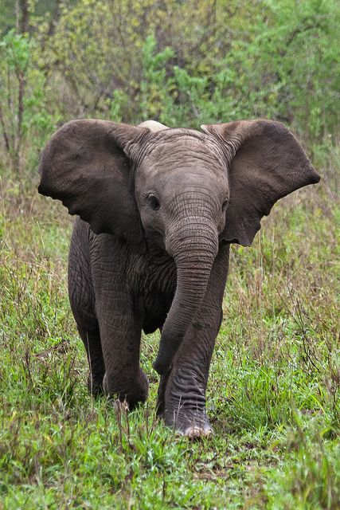
Elephant
Localization
...involves what is in the picture and where is it?

Slide 7
Elephant
How do we build this?

Slide 8
Classification
Cat
FC Layer
Convolution
Layers
Feature
Map
Dog
. . .
Bird
Elephant
Models which we have built so far...

Slide 9
Classification
FC Layer
Class Probability
Convolution
Layers
FC Layer
Box Coordinates
Transfer Learning
(x, y, W, h)
Regression
Localization requires both Classification and Regression in the same model

Slide 10

How many outputs from the model?

Slide 11
FC Layer
Classification
# of classes
Convolution
Layers
FC Layer
4
Transfer Learning
(x, y, W, h)
Regression
Localization requires both Classification and Regression in the same model

Slide 12
What will be the LOSS function?

Slide 13
FC Layer
Classification
Convolution
Layers
Cross Entropy
FC Layer
Regression
Transfer Learning
MSE / RMSE/MAE
Loss in Object Localization

Slide 14
How do we measure model’s performance?

Slide 15
FC Layer
Classification
Convolution
Layers
Accuracy
FC Layer
Regression
Transfer Learning
?
Loss in Object Localization

Slide 16
Intersection over Union
(IOU)
An approach to measure localization accuracy

Slide 17
Predicted Box
Actual Object Box
Actual bounding box in the data

Slide 18
Intersection area
Area common between both anchor box and actual box

Slide 19
Intersection area
Union area
Area covered by either box

Slide 20
IOU = a / b
Intersection area (a)
Union area (b)

Slide 21
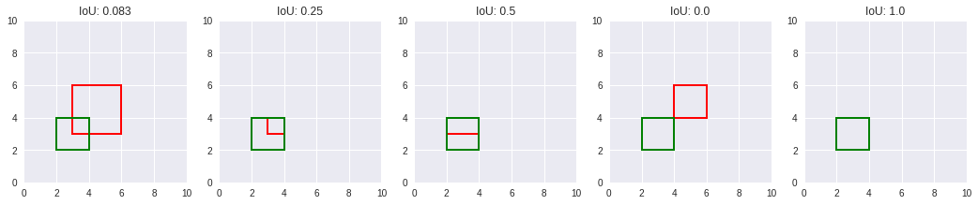
IoU provides a simple way to understand overlapping between two boxes

Slide 22

Data for Localization

Slide 23
PASCAL
VOC
COCO
(Common objects in Context)
http://host.robots.ox.ac.uk/pascal/VOC/
http://cocodataset.org
IIIT Oxford Pets Dataset
Some examples of datasets for object localization
http://www.robots.ox.ac.uk/~vgg/data/pets/

Slide 24
How do we prepare data for Object localization model training?

Slide 25
What is needed?
Elephant
Images
Classification Label
Bounding Box Coordinates

Slide 26
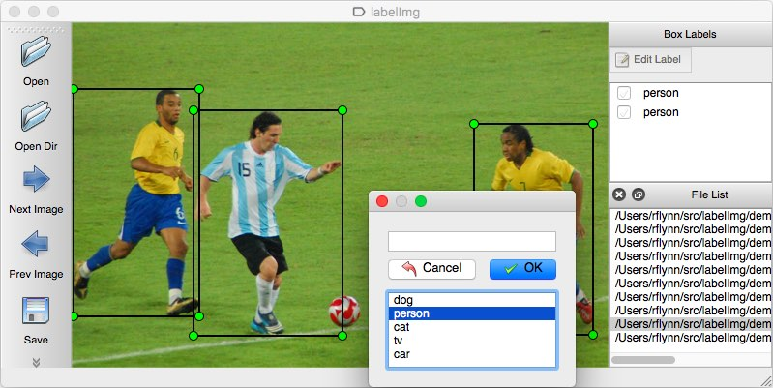
LabelImg tool
https://github.com/tzutalin/labelImg

Slide 27
Install & try LabelImg
https://github.com/tzutalin/labelImg

Slide 28
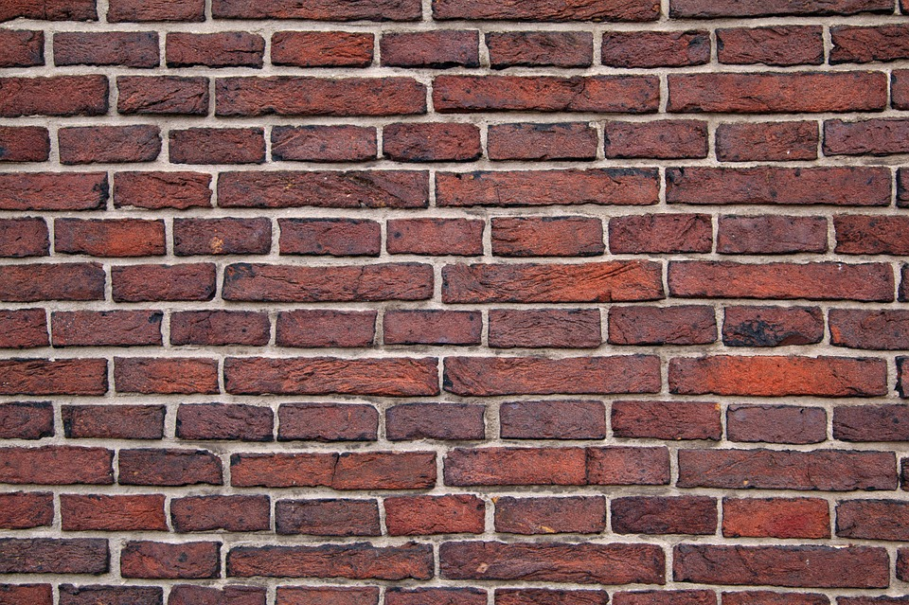
Building
Object Localizer
(Pets Dataset)

Slide 29
Images
Download Data
(tarfile)
Extract Data
to Disk
Annotations
Class label and bounding box for the pet object in image
(xml file for each image)
Data preparation steps

Slide 30
Images
Download Data
(tarfile)
Extract Data
to Disk
Store all the XML files info in a single CSV file
Annotations for each image in individual XML file
Data preparation steps

Slide 31
Images
Download Data
(tarfile)
Extract Data
to Disk
Store all the XML files info in a single CSV file
Annotations for each image in individual XML file
Visualize Image and Annotations
Data preparation steps

Slide 32
Images
Download Data
(tarfile)
Extract Data
to Disk
Store all the XML files info in a single CSV file
Annotations for each image in individual XML file
Build Batch Generator
Visualize Image and Annotations
Data preparation steps

Slide 33
Building the model
for
Object Localization

Slide 34
3. Classification Layer with Softmax
1. Load Pre-Trained ResNet50
2. Add some Custom Layers
Final Model
Frozen Layers
Trainable Layers
4. Regression Layer with Sigmoid
Model : 1 input, 2 outputs

Slide 35
Classifier Loss
Categorical Cross-entropy
x 20
Total Loss
Regressor Loss
Mean Absolute Error (mae)
x 1

Slide 36
Object Localization
Exercise

Slide 37
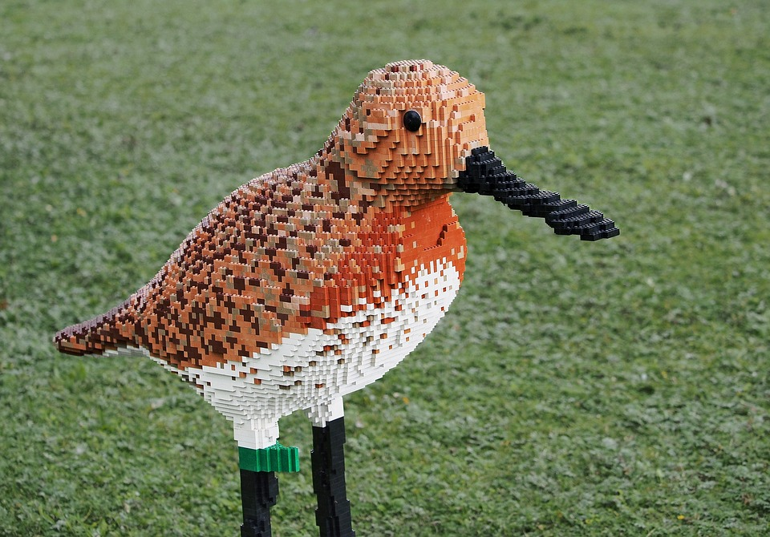
Image Augmentation
For
Localization

Slide 38
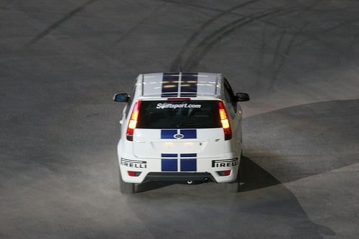
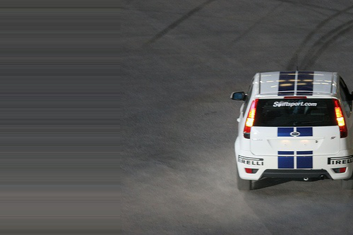
Original Image
Augmented Image (Shift width wise)
No issue in classification

Slide 39
Regression will be an issue

Slide 40
Keras ImageDataGenerator
...does not move boxes after augmentation

Slide 41
ImgAug
Augment images and bounding boxes
imgaug.readthedocs.io

